Slide 1

JOURNEY MAP
XBOX SERIES S

Slide 2
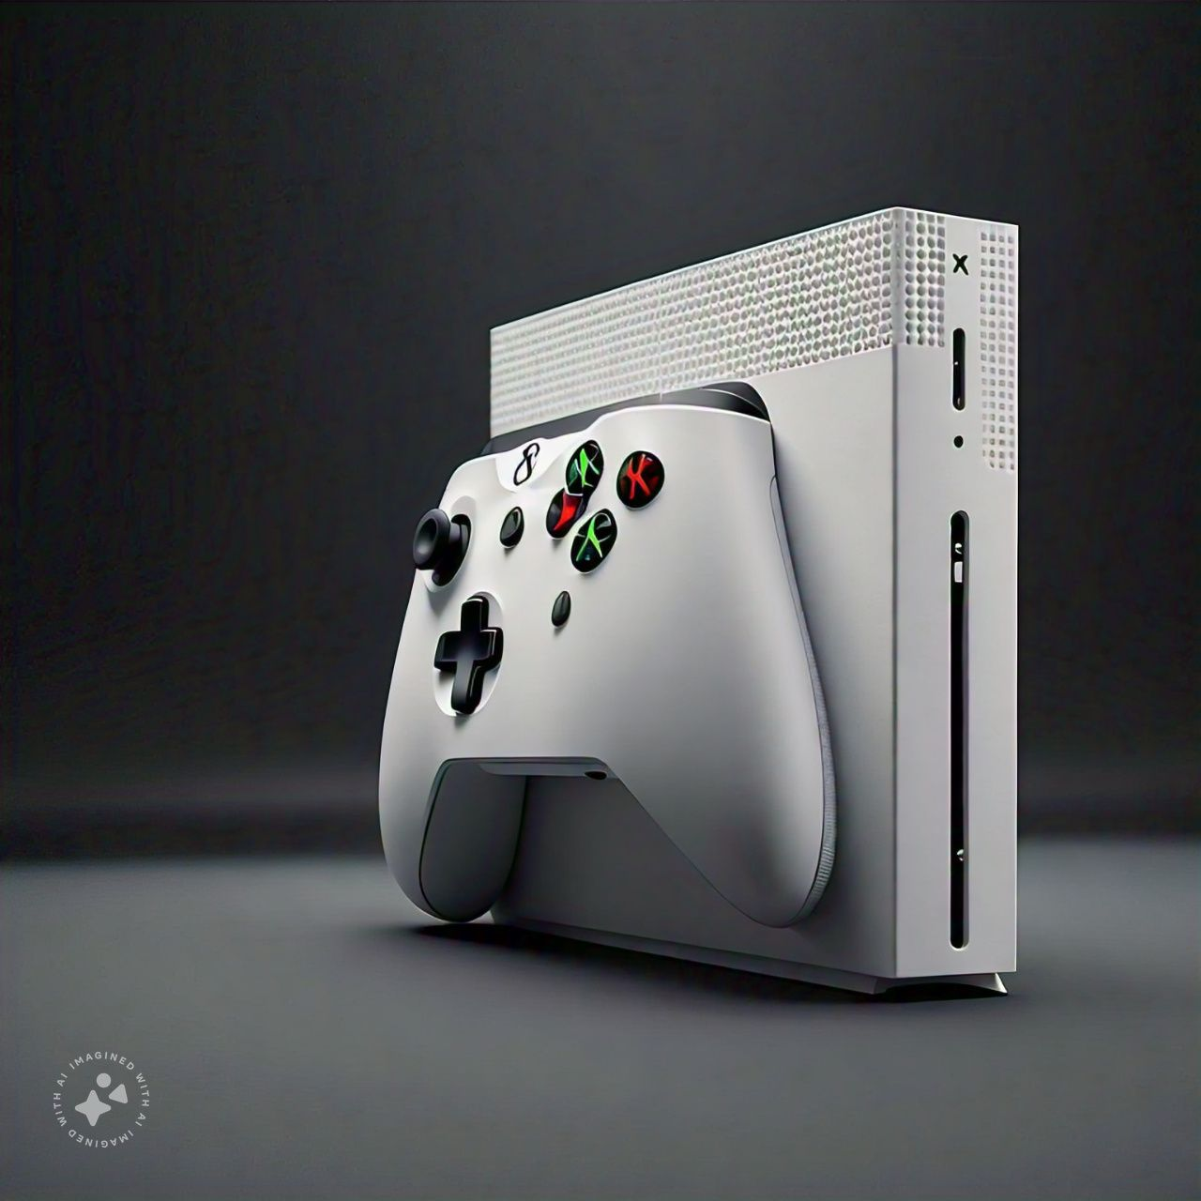
OVERVIEW
The Xbox Series S is a next-generation gaming console developed by Microsoft, released on November 20, 2020. It’s a more affordable, digital-only version of the Xbox Series X.
Specifications:
Dimensions : 278mm × 151mm × 63mm
Weight : 2.7 lbs(1.23 kg)
Power : 85W
Ports : HDMI 2.1, USB 3.2, Ethernet
Pricing:
The Xbox Series S is priced at $299.99(base model)

Slide 3
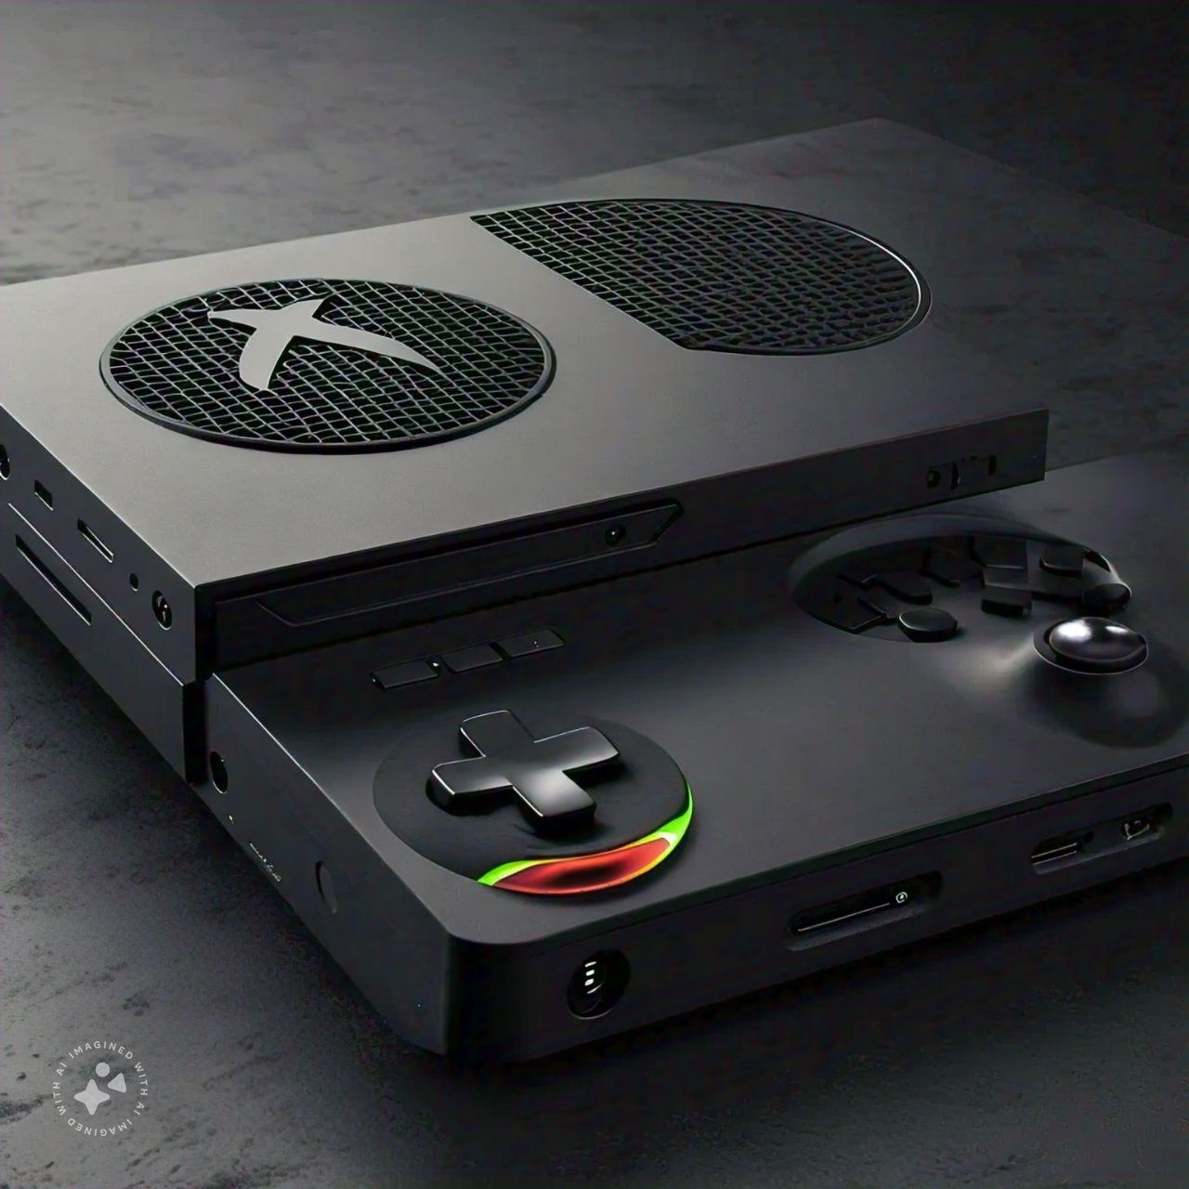
KEY FEATURES
Processor: Custom AMD Zen 2 CPU (3.4 GHz)
Graphics: Radeon RDNA 2 GPU (4 TFLOPS)
Memory: 10 GB GDDR6 RAM
Storage: 512 GB SSD
Resolution: Up to 4K (3840 x 2160)6
Frame Rate: Up to 120 FPS
Ray Tracing: Real-time ray tracing support
Backward Compatibility: Compatible with Xbox, Xbox 360, and Xbox One

Slide 4

ADVANTAGES
Affordable entry point into next-generation gaming
Compact design
Fast load times
Impressive performance for its price
DISADVANTAGES
Limited storage capacity
No disc drive
Less powerful GPU compared to Xbox Series X

Slide 5

CONCLUSION
The Xbox Series S offers an affordable and compact gaming experience with impressive performance, making it an excellent choice for those new to gaming or looking for a secondary console.

